Slide 1
Planning and Estimating

Slide 2
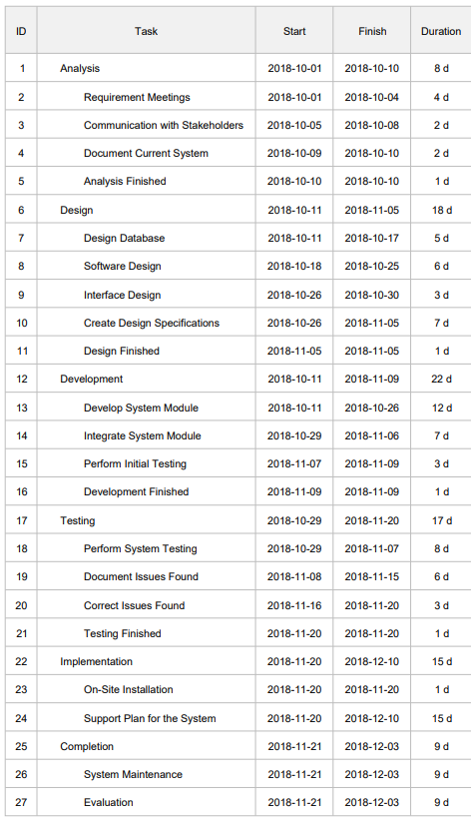
Traditional Planning and Estimating
Gantt Chart with Duration Estimates
Traditionally estimation is done based on historical efforts assuming similar work has been done before
Traditional estimation is usually based on “expert opinion” where one person provides an estimate of duration or effort required for various tasks or high level activities
Estimates are typically “baselined” which means they are locked down and only change requests or significant new information allows the estimate to be changed
Traditionally many see estimates as more of a contract

Slide 3
Activity planning vs Feature planning
Traditional approaches to planning focus on completion of activities instead of the delivery of features, the Gantt chart or work breakdown structure identifies the activities to be performed and that is how progress of the team is measured
Activity based planning gives the customer no value from the completion of activities instead features are the unit of customer value.
When a traditional schedule is being reviewed it is being looked at for forgotten activities instead of missing features
Often activity based planning leads to schedule overruns due to: activities that don’t finish early, lateness is passed down the schedule, activities are not independent
Agile Estimating and Planning

Slide 4
Uncertainty
Another shortcoming of the traditional approach to planning is a failure to acknowledge uncertainty (uncertainty about the product) and assume the initial requirements led to a complete and perfect specification of the product
We also ignore the uncertainty about how the product will be built and think we can assign precise estimates (i.e. 2 weeks) to imprecise work. We can’t hope to identify every activity that will be needed in the course of a project.
Even with the uncertainty traditional schedules are expressed as a single date such as we will ship this product on June 30th.
Agile Estimating and Planning

Slide 5
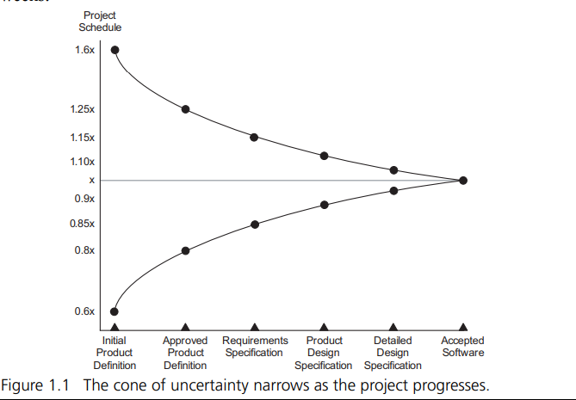
Cone of Uncertainty
In 1981 Barry Boehm created the first version of what was later called the “cone of uncertainty” by Steve McConnell (1998). This cone of uncertainty shows initial ranges of uncertainty at different points during a waterfall process. For example during the feasibility phase a schedule estimate is typically off by from 60% to 160%, or a 20 week project could take from 12 to 32 weeks. As phases go by the uncertainty decreases. After requirements are written the estimate might still be off by 15%, with an a 20 week project taking 17 to 23 weeks
Agile Estimating and Planning

Slide 6
Cone of Uncertainty
During the early part of a project we have the most uncertainty. Estimates should reflect this uncertainty and reflect a range such as we will ship between June and August
As a project progresses and uncertainty is removed estimates can be refined and made more precise
To deal with this uncertainty in Agile we iterate working in short iterations and show working software to users every few weeks
This shifts from a plan to planning

Slide 7
The Unknown
In traditional project management areas such as construction estimates based on historical information or dimensions such as x hours or y dollars per square foot can be used
Scrum is built on the observation that software development is a very complex endeavor making it impossible to arrive at accurate estimates.
Accurate estimates are impossible, the most thorough, detailed technique can not cover all scenarios, potential issues, and insights that may emerge
An estimate can not be a guarantee
The time spent on estimation is a form of waste. Estimates are inaccurate at best and the work we are estimating is likely to change over time

Slide 8
Agile Planning
Agile teams typically plan at 4 levels
Product planning – product vision and roadmap
Release planning – determine either the scope that can be completed by a deadline or determine a potential completion date based on scope
Sprint planning – planning the activities for a specific sprint to obtain a specific sprint goal
Daily planning – done in the Daily Scrum meeting
We have already explored product planning while discussing product visioning. We will discuss release and sprint planning in the next lesson and daily planning in the lesson after

Slide 9
Scrum and Estimating
The Scrum Guide has only a couple references to estimate in it
“Product backlog items have the attributes of a description, order, estimate, and value”- this says a product backlog item should have an estimate of it’s size
“The Development Team is responsible for all estimates. The Product Owner may influence the Development Team by helping it to understand and select trade-offs, but the people who will perform the work make the final estimate” – only the Development Team estimates the work that is to be done. They do not rely on outside expert opinion

Slide 10
Scrum and Estimating
The Development Team in Scrum performs two different levels of estimates. The first is at the Product Backlog Item during Product or Release planning and the second is the Task level during Sprint Planning.
Task level estimates during Sprint Planning are typically done in hours or at the most a day or two. The Task level is completed by the Development Team member or members that will work on that task. We will discuss more about this when we talk about Sprint Planning
The team can determine how to perform both of these estimates. One technique of Product Backlog Item estimating is story points but the team can come up with their own way of estimating.

Slide 11
Story Points
Story Points unit of measure that can be used for estimating by an Agile team. It is not part of the Scrum Guide. This approach was created by Mike Cohn
What are Story Points? – Mike Cohn
https://www.youtube.com/watch?v=VsSaolMtkKU
(length 6:17)
What are the components that make up the story point?

Slide 12
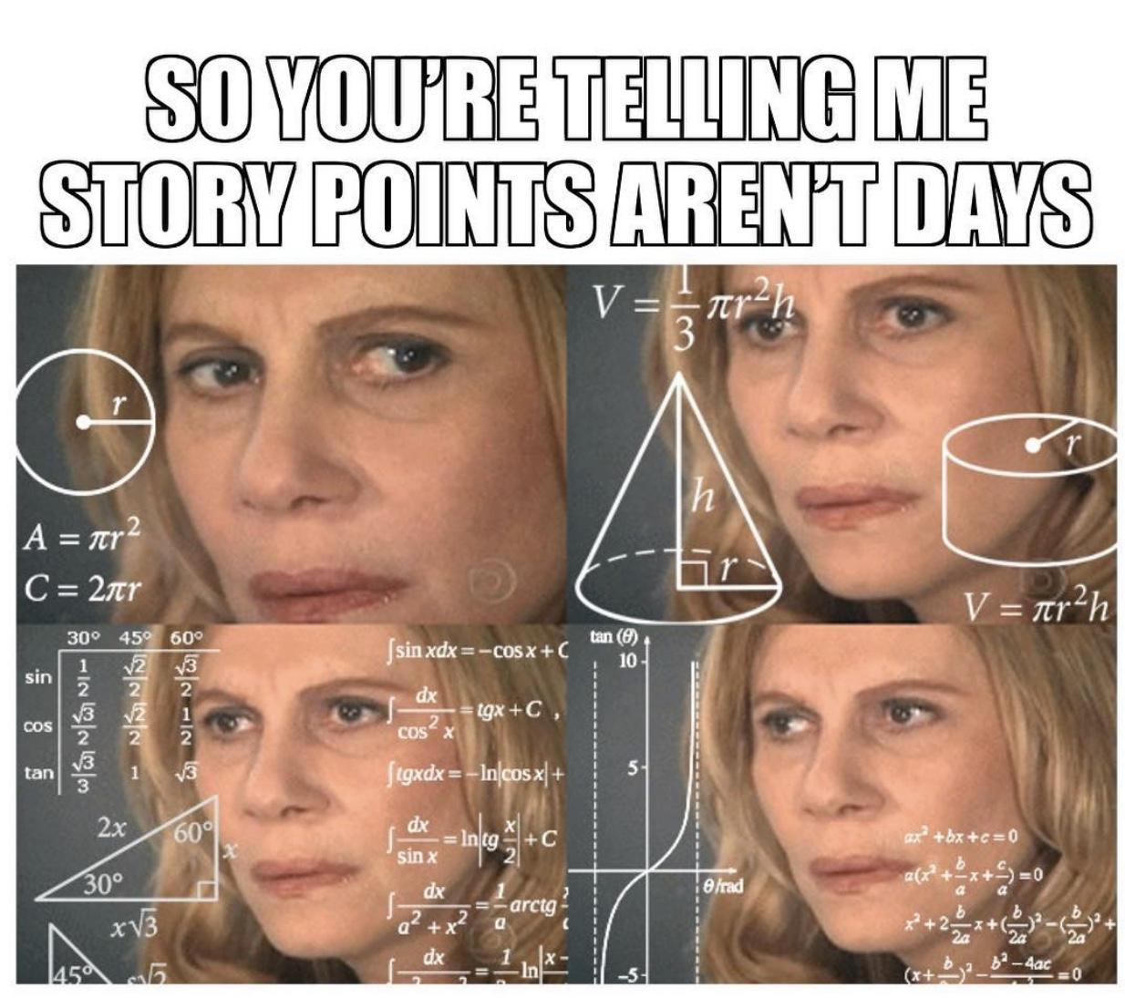
Story Points are not days
One difficulty with using Story Points with teams transitioning from traditional waterfall is the concept of Story Points not being in days or hours but instead dealing with relative size
1,2,3,5,8,13,20

Slide 13
Planning Poker
Planning Poker is a technique that can be used for determining Story Points. The Planning Poker technique was also created by Mike Cohn
Planning Poker – Mike Cohn
https://www.youtube.com/watch?v=MrIZMuvjTws
(length: 5:30)

Slide 14
Why Estimate in Scrum?
Estimating helps focus the conversation within the Development Team on what is needed for a particular item as it requires a conversation between members about what is involved, how should it work, and what work is needed
Agile estimating is more about the conversation than the and discussions that it triggers than the actual result of estimating (i.e number of story points)

Slide 15
Estimating Your Team Product Backlog Items
Use Pointing Poker https://www.pointingpoker.com/
One team member click Start a Session on the home page of this site
Under Name enter your name and click Join Session
Send link to other team members or enter email addresses to other team members
Once each team member is in the session then one person take the product backlog item information from Scrummage and put into the Story Description, all team members will be able to see the description
Each team member will select number of points and when all have selected a value you will see everyone’s points

Slide 16
Additional Resources
Agile Estimation
https://www.youtube.com/watch?v=7nTxdl29ePY
(length: 11 mins)

